Slide 1
Robotics Triathlon Project Presentation
By: Holly Bernich, Nolan Beagell, and Anthony Berardis

Slide 2
Roles:
Holly - Project Manager/Tester
Nolan - Code Implementer/Tester
Anthony - Document Manager/Chart Maker

Slide 3
Software Engineering Concepts:
Some things our group learned about software engineering include
Testing project
Project Management
Documentation
Adjustments based off time and requirements

Slide 4
Challenges Faced:
Robot was inconsistent sometimes, doing things differently each time it was told to do so.
The robot does not measure distance in the air, so the binder jump was difficult in Sprint 3.
Robot performed differently with the cover on and the cover off.

Slide 5
What We Would Do Differently:
Even though we tested our code multiple days a week, there is never enough testing when it comes to software engineering.
Adjust our aim/placement of the robot more rather than the code itself.
Try a different approach to the code instead of the standard way of thinking, be more creative with block code.

Slide 6
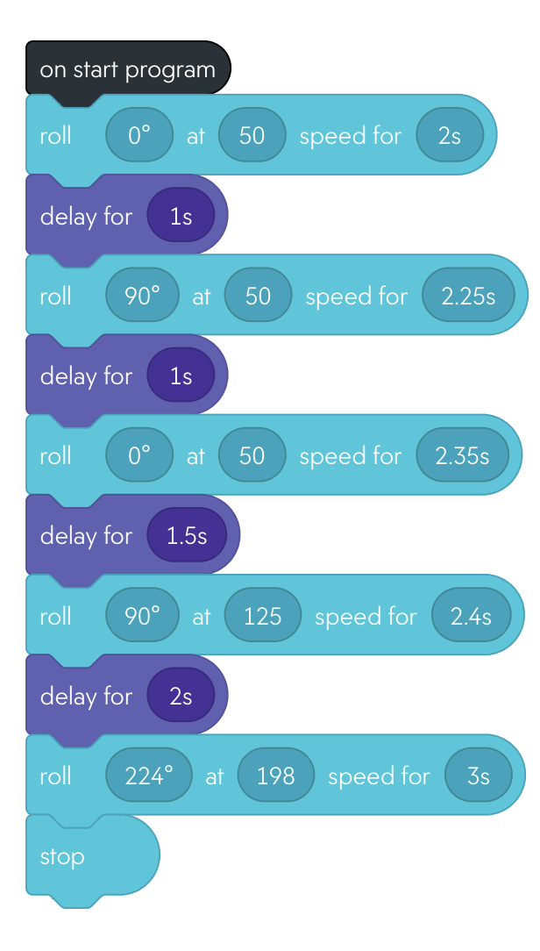
Sprint 3 Agility Code:
async function startProgram() {
await roll(0, 50, 2);
await delay(1);
await roll(90, 50, 2.25);
await delay(1);
await roll(0, 50, 2.35);
await delay(1.5);
await roll(90, 125, 2.4);
await delay(2);
await roll(224, 198, 3);
stopRoll();
}

